Slide 1
Running Open-Source Machine-Learning Models On-Premise
Malte Groth

Slide 2
The title of the talk in one diagram
“Providing access to Open-Source Machine-learning Models via self-hosted Web-Services for Inference”
on-premise infrastructure
App
http
API
Model
ModelHubs
App
gRPC
ModelServingRuntime
App

Slide 3
Running Open-Source Machine-Learning Models On-Premise

Slide 4
Open-Source Machine-Learning Models
… are models available under an Open-Source License (e.g. Apache 2.0)
Sources: HuggingFace, torch.hub, Github
Do not confuse Open-Source with Openness: Open-Source models differ in terms of transparency, reproducibility and quality control.

Slide 5
Advantages of Open-Source Machine-Learning Models
Transparency and Reliability
Availability
Adaptability
Performance
Autonomy (Avoiding Vendor-Lock-In)
Cost-Saving
Of particular interest in Medicine: Transparency, Reliability and Adaptability

Slide 6
Running Open-Source Machine-Learning Models On-Premise

Slide 7
On-Premise
Deployments and operations are located within physical premises of a company/organization
Opposite of the cloud
Full control over IT infrastructure, data and applications

Slide 8
Motivation for running Models on-premise
Data Security and Privacy
Latency and Performance
Cost-Saving
Offline Access
Control over intellectual property
Flexibility → especially true if following a ...

Slide 9
Cloud-agnostic deployment strategy
Designing your Applications, tools and services in a way so they can migrate seamlessly between multiple cloud platforms and on-premises.
AWS
On-Prem
GCP
Application
Azure
On-Prem
StackIT

Slide 10
Kubernetes
"Kubernetes (k8s) is a ...
open-source
container orchestration system
for automating software deployment, scaling and management."
And it is a key technology for implementing a cloud-agnostic deployment strategy because it
abstracts the underlying infrastructure
has a consistent tooling and user interface
provides scaling at ease

Slide 11
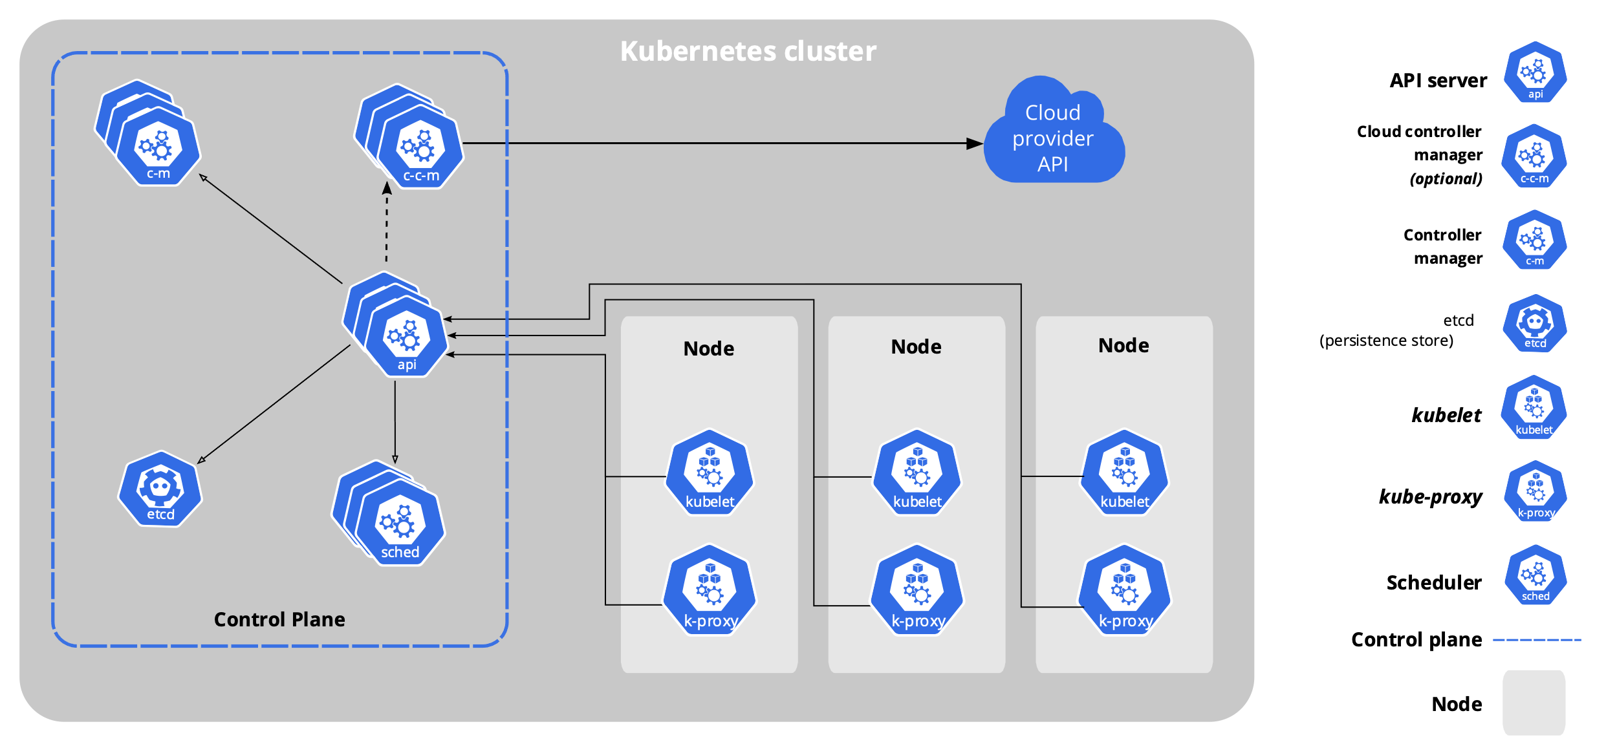
Kubernetes

Slide 12
Running Open-Source Machine-Learning Models On-Premise with Kubernetes

Slide 13
KServe: Model Inference Platform on Kubernetes
KServe
offers (auto)scaling, e.g.
if number of requests increases
if there is no load at all (scale to zero)
standardized inference protocol across ML frameworks
simplifies model deployment

Slide 14
Running Open-Source Machine-Learning Models On-Premise In Practice

Slide 15
Example
Download model files from external source
Prepare model files
Store the prepared model on model storage
Create an InferenceService
InferenceService takes care of running the model serving runtime

Slide 16
Summary
Open-Source Machine-Learning Models have a lot of advantages.
There are many reasons why it may be appropriate or even necessary to deploy models on-premise.
You can gain high flexibility by choosing a cloud-agnostic approach.
Kubernetes is a key technology for implementing a cloud-agnostic deployment strategy.
KServe is a inference platform suited for deploying models in production on Kubernetes.

Slide 17
Thank you for your attention

Slide 18
Why Kubernetes?
High Availability:
K8s clusters consists of multiple nodes
K8s controllers enable service (pod) replication
K8s controllers provide self-healing mechanisms
Resource Efficiency:
K8s comes with a powerful scheduling
Link: https://dzone.com/articles/kubernetes-advantages-and-disadvantages

Slide 19
InferenceService
InferenceServices
provide Inference APIs out-of-the-box
support multiple ML frameworks/Model Serving Runtimes
support for obtaining models from different storage locations
provide Autoscaling, incl. Scale-To-Zero
"Since your model is being deployed as an InferenceService, not a raw Kubernetes Service, you just need to provide the storage location of the model and it gets some super powers out of the box 🚀."

Slide 20
InferenceService
Pod
API
MSR
Request
Model
Storage

